Slide 1
Weather Classification using IBM Cloud Visual Recognition
Submitted by
Nisiselvan SJ(710021106024)
Anna university Regional Campus
Coimbatore

Slide 2
Contents
Feature Engineering
Training the model
Testing the model
Evaluation of Accuracy

Slide 3
Feature engineering
Feature engineering in machine learning involves selecting, transforming, or creating meaningful input variables from raw data to improve model performance.
It encompasses tasks such as feature selection, data transformation, dealing with categorical data, and handling missing values.
Effective feature engineering can significantly enhance the accuracy and generalization of machine learning models, often requiring domain knowledge and an iterative approach to refine feature choices.

Slide 4
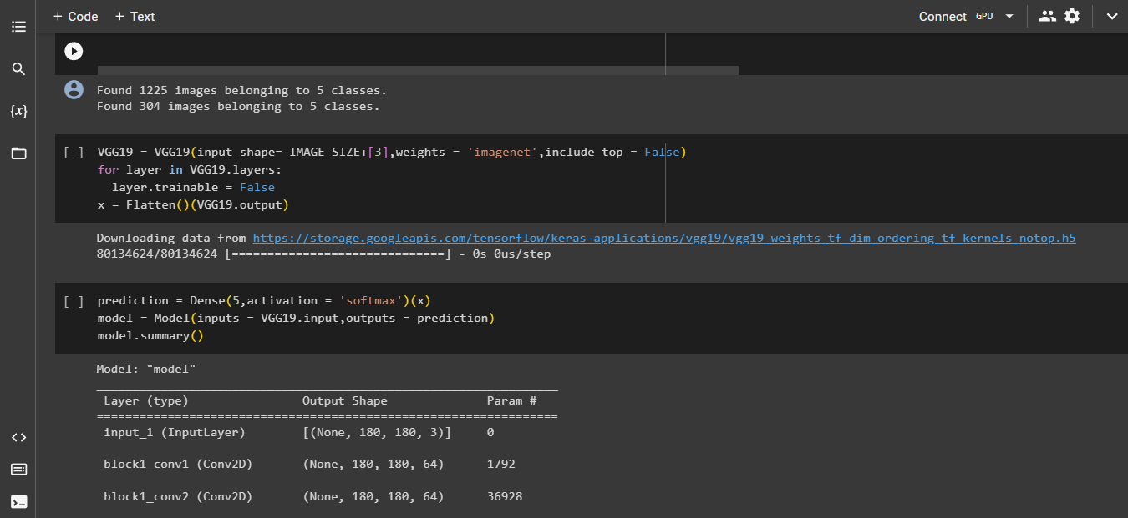
code

Slide 5
Training the model
The optimizer used by our model is “Adam”, it is the most common optimizer used in image classification.
The Loss function used here is “Categorical Crossentropy” which is usually used in the multiclass classification problems where the target variable is labelled not numbered.
After training the model we achieved an Accuracy of 85.71% . Then the model file with h5 extension is saved and it is downloaded as “wcv.h5” 2!

Slide 6
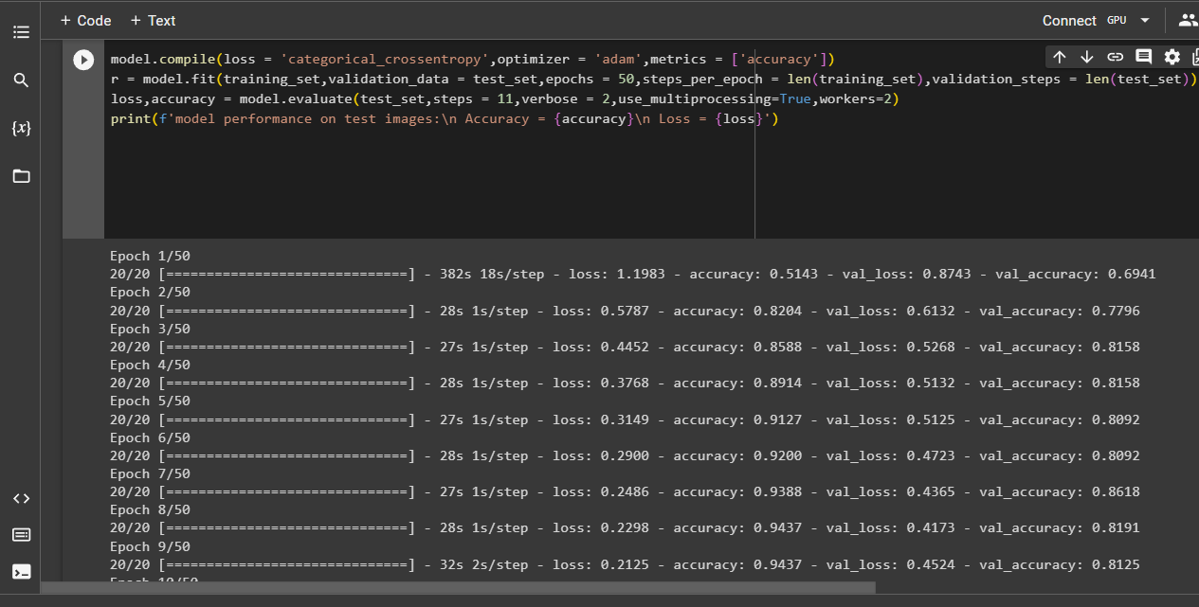
code

Slide 7
Testing the model
After saving the model we started testing the model with random images from the test datset which our model never seen before I.e., the images in the test set and and training set are different.
We tested our model with two random images both are predicted correctly.

Slide 8
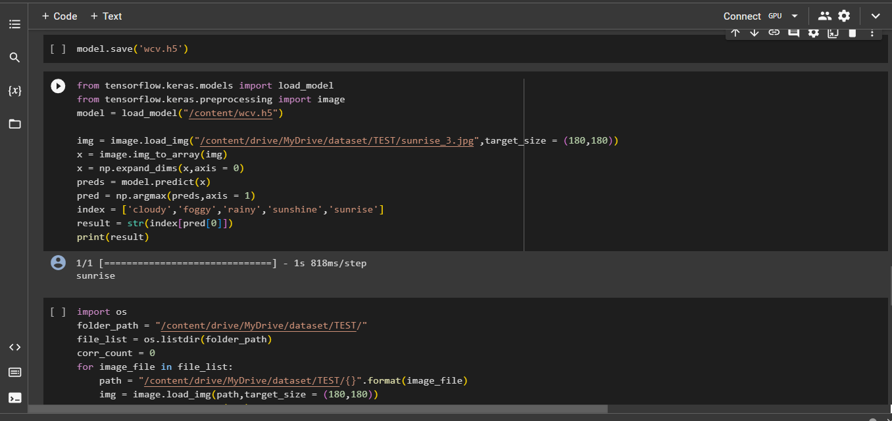
code

Slide 9
Evaluation of Accuracy
Accuracy is an important metric in building an ML model.
The Accuracy of our model is found to be
85.71 %

Slide 10
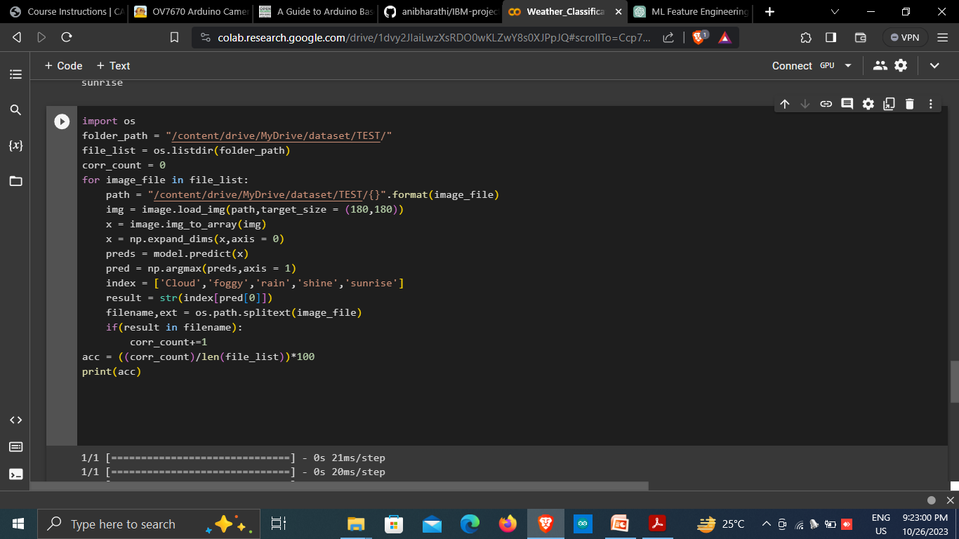
code

Slide 11
Thank You!

